Slide 1
Android Programming Education

Slide 2
Android Programming Education
Android is an opensource operating system for mobile devices. Android is a popular platform for mobile application development. Android development tools are important for Android application development. Android development tools include Android SDK and App Inventor. Android SDK is a set of tools for developing Android applications. App Inventor is a webbased, dragdrop visual development environment for creating Android applications.

Slide 3
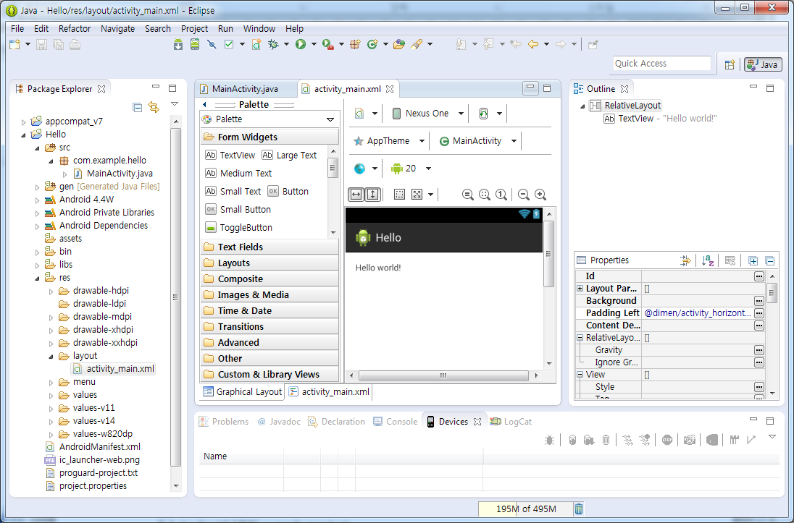

Slide 4
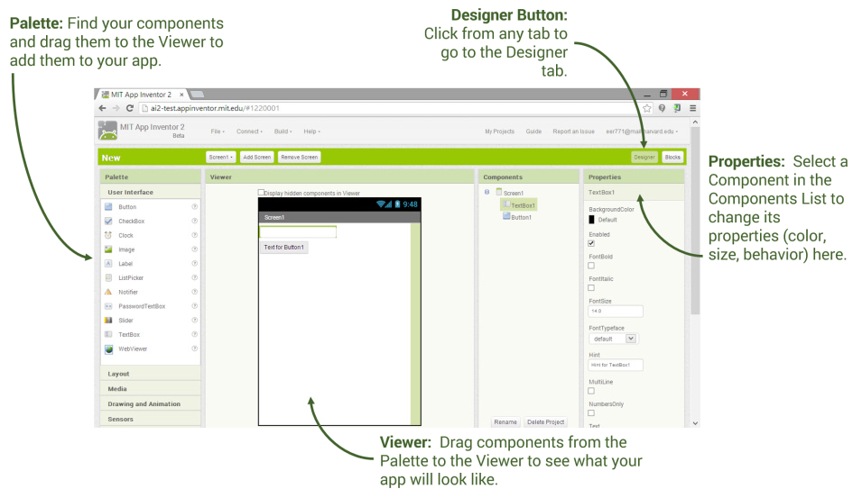

Slide 5
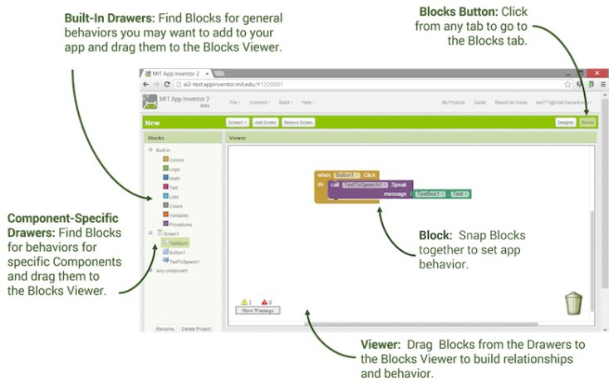

Slide 6
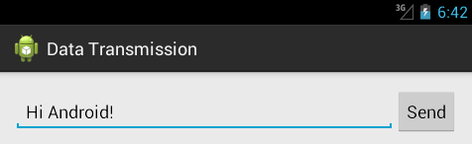

Slide 7
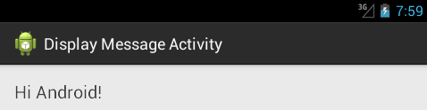

Slide 8
Android app development
In this paper, we introduce the basic skills of Android app development. We introduce the basic skills of Android app development by using Android Studio and App Inventor.

Slide 9
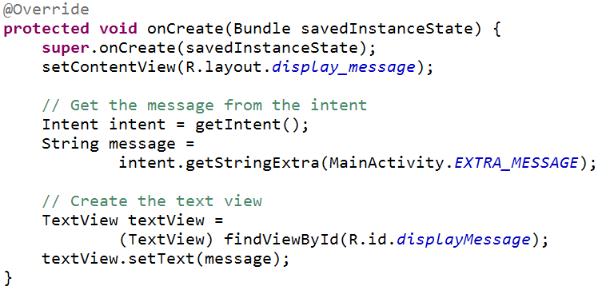

Slide 10
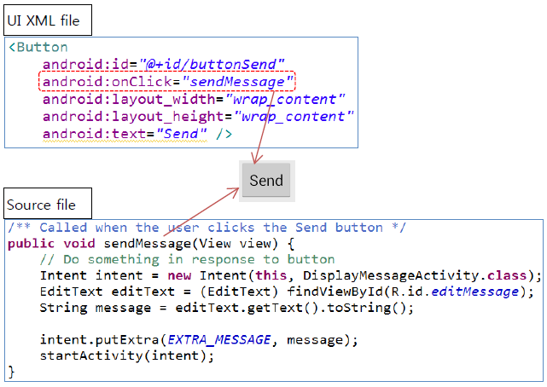

Slide 11
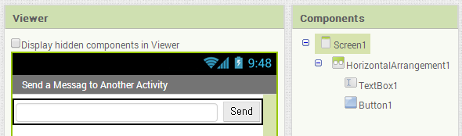

Slide 12
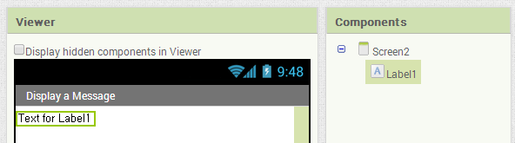

Slide 13
Android Programming Education Model
This paper presents a new model for Android programming education using multi Android development tools. This model is designed to be more efficient compared to education using Android SDK only. This model is applied to a course opened in the second semester of 2013.

Slide 14


Slide 15


Slide 16
Android app development
Android app development education is designed using Android SDK and App Inventor. The Android app development education model is more efficient than Android app development education using Android SDK only.

